Slide 1
Group 17
Pet Registration and Trend Prediction Task
Group members: Contribution:
Trang Nguyen : 6166994 | tttn941 25%
Mohamed Ramshad Basheer: 5247469 | mrb685 25%
Gengchang Xu : 5813384 | gx505 25%
Shafia Paracha : 6153239 | sp860 25%
Notes:
Specificly that there was 0 contact from rodney and we have no idea why, hence he is not part of this presentation to ensure we do not get marked down for lack of participation.

Slide 2
Outline
Objective
Visualisation and Preprocessing
Analysis and Results
Performance Evaluation

Slide 3
Objective
Explore the relationship between the suburb (and its demographics) and the popularity of the breeds and colours of cats and dogs registered..
Propose two different models to predict whether an animal will be desexed based on other information available (species, location, when born, etc.).
Discuss the strengths and weaknesses of the models and our preferred one.

Slide 4
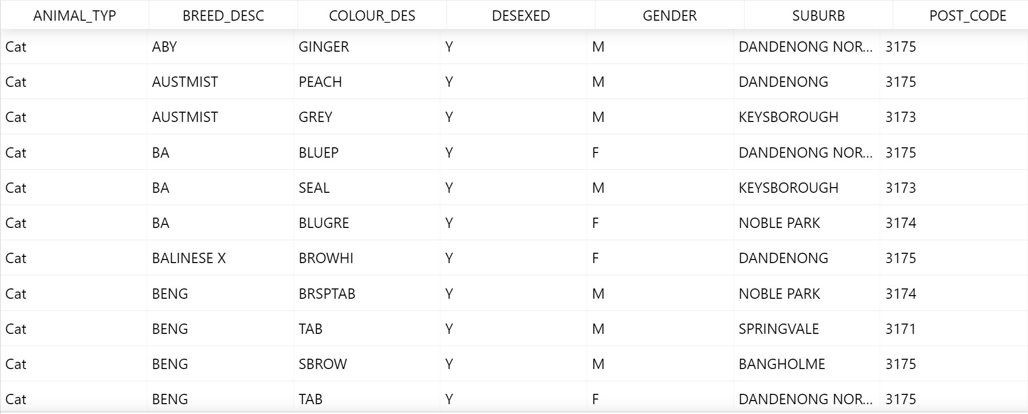
Datasets
Figure 1: A fraction of the dataset of cats
Notes:
There are two datasets for registered dogs and cats.
The datasets were created in 2016 and updated in 2019
Date born removed from original dataset and after discussing with tutor we were asked to ignore it therefore we could not study any date related questions

Slide 5
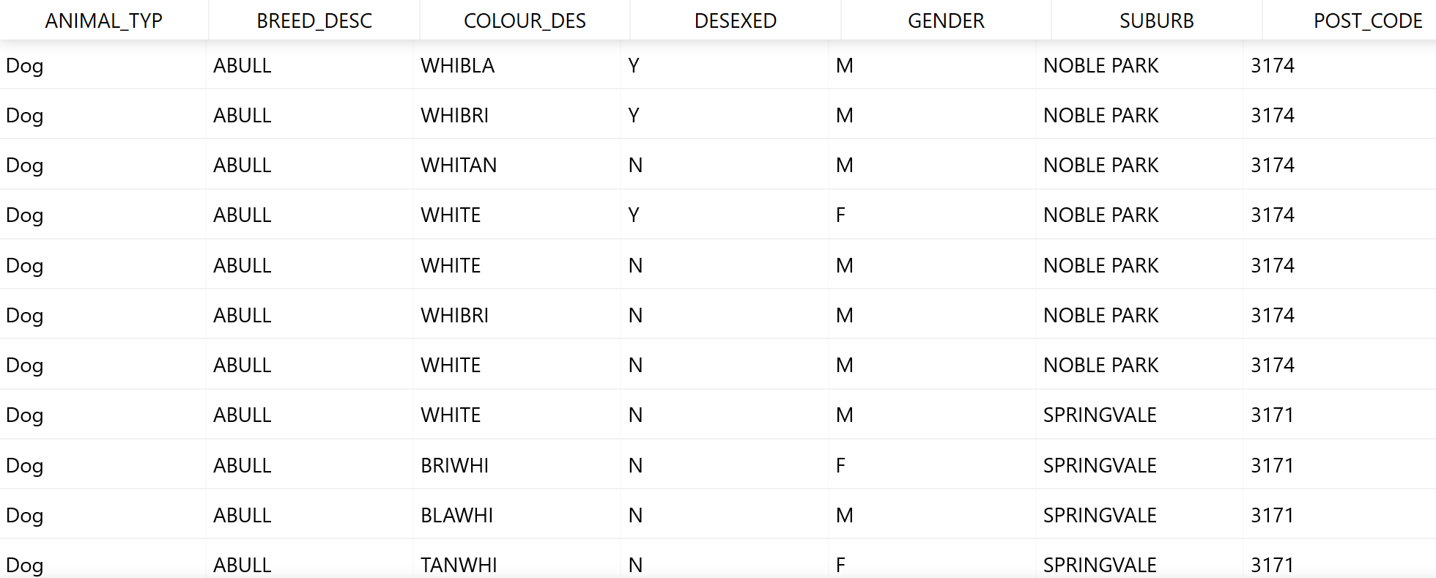
Datasets
Figure 2: A fraction of the dataset of dogs

Slide 6
Data cleaning
Merging the two datasets together
Into one dataset called “animals”
We rename the animal type column to ANIMAL_TYPE for better readability.
Removing missing values
Found 3 dog records with missing colour values

Slide 7
Data visualization
Notes:
To study and understand the datasets better we use different visualization techniques

Slide 8
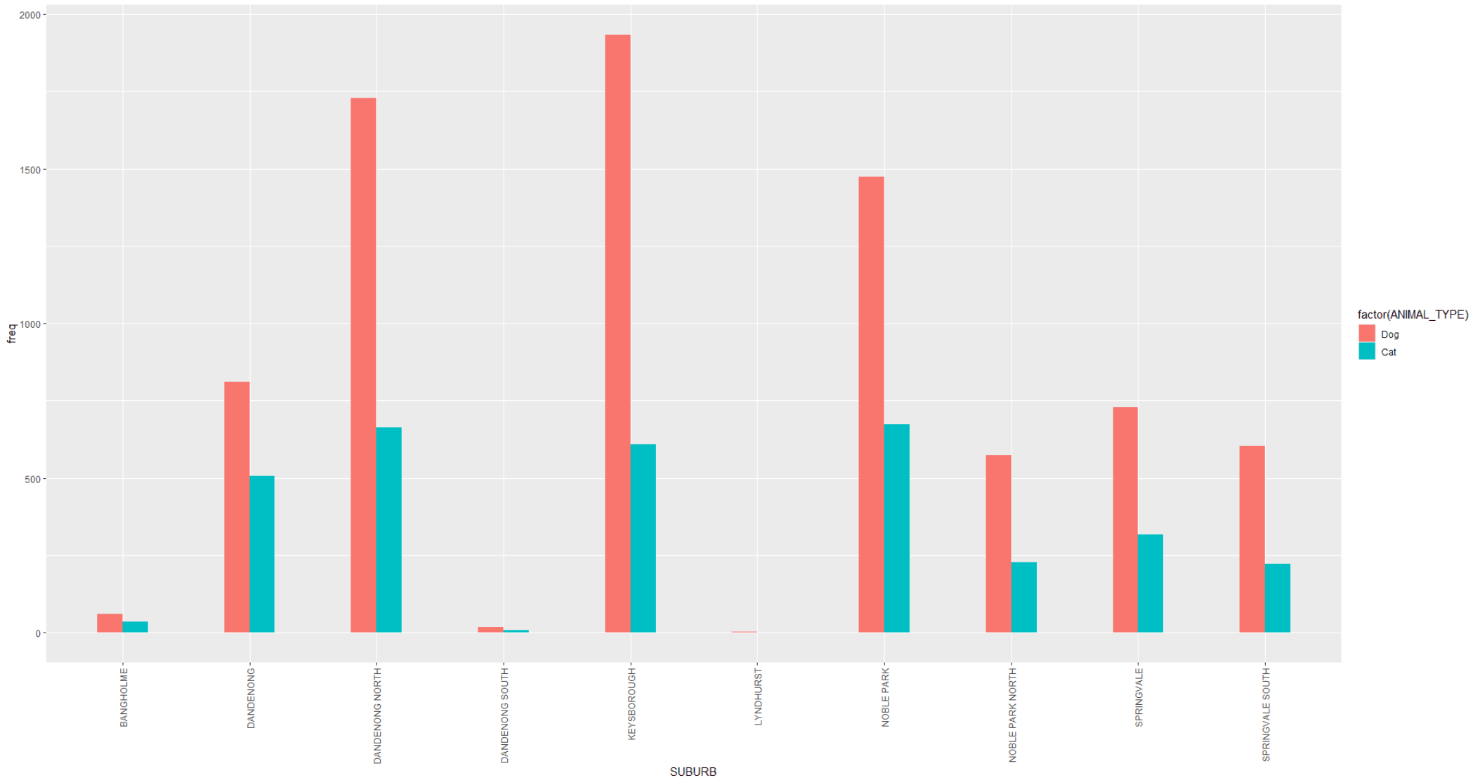
Data Visualisations - Overview
Figure 3: The distribution of cats and dogs by suburbs
Notes:
This figure shows the distribution of the registered cats and dogs by suburbs.
Overall, dogs are significantly more popular than cats.
The number of cats are more consistent across the suburbs than dogs. Suburbs with more dogs are more likely to have more cats.
The total number of animals also fluctuates across the suburbs.
Bangholme, Dandenong South and Lyndhurst have notably fewer number of animals compared to the other suburbs.

Slide 9
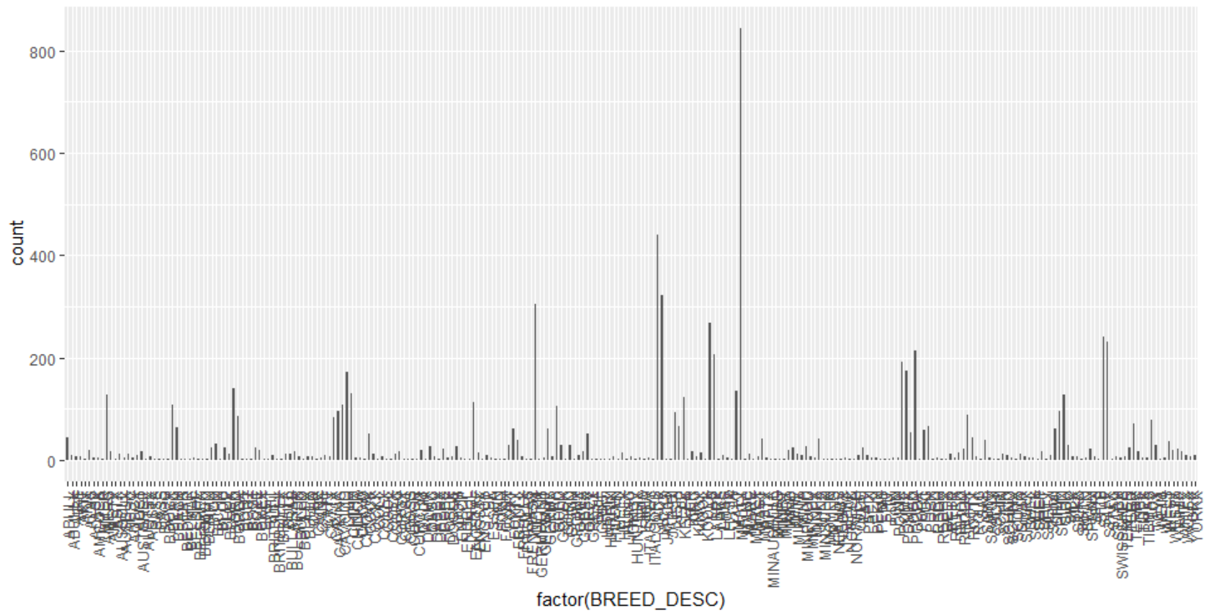
Data Visualisations - Categorical variables
The dataset is imbalanced in terms of dog breeds.
The plot is unimodal.
Figure 10: Counts of all dog breeds
Notes:
There is a large number of levels for this categorical variable.
The number of samples for the levels are not consistent with one level being significantly more popular than the other.

Slide 10
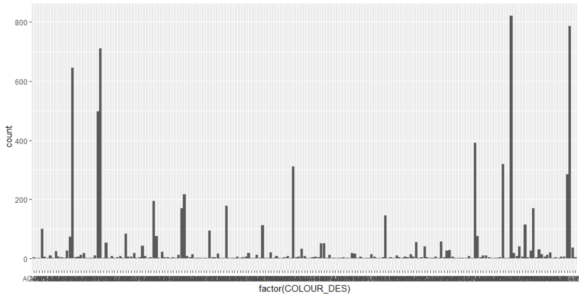
Data Visualisations - Categorical variables
The plot is bimodal overall with colours towards the two ends of the x-axis being the more popular.
Figure 11: Count of all dog colours

Slide 11
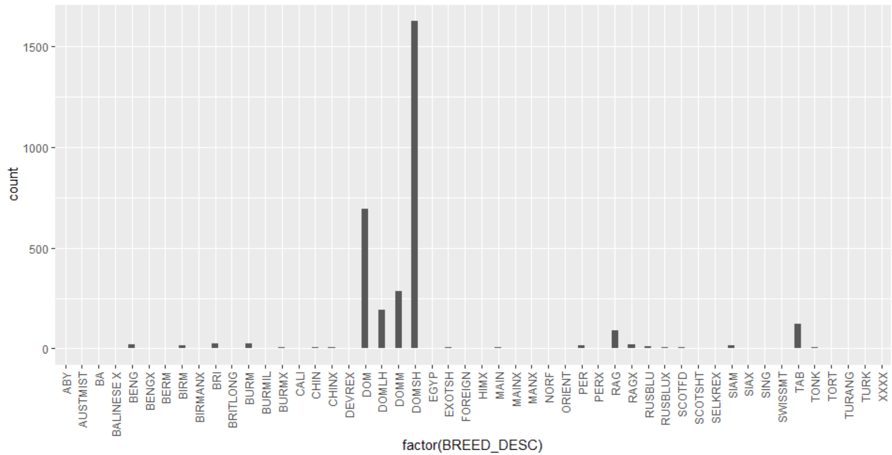
Data Visualisations - Categorical variables
There are fewer types of cat breeds compared to dog breeds.
There is also a focus on 6 breeds, namely DOM, DOMLH, DOMM, DOMSH, RAG and TAB. These six breeds are notably more popular than the others.
Also, there is a consistently small number of populations for each of the other breeds.
Figure 9: The distribution of the cat breeds

Slide 12
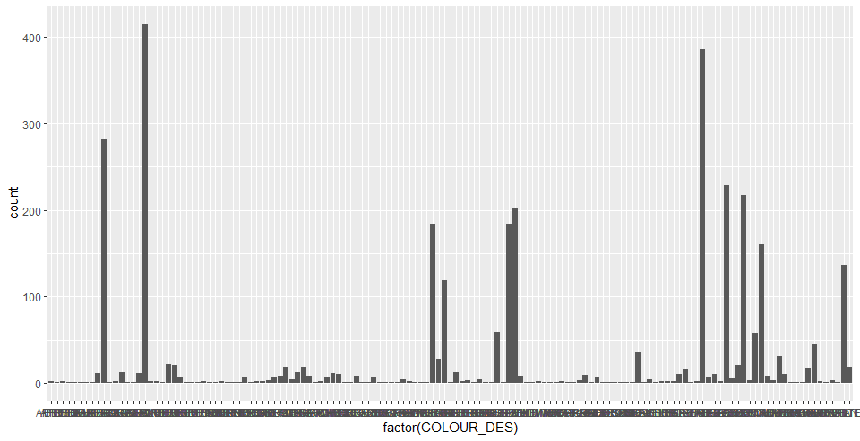
Data Visualisations - Categorical variables
The plot is trimodal, showing an uneven distribution of the colours of cats.
There exist colour categories that have too few samples.

Slide 13
Exploration of demographic relationship
The relationship between the suburb demographics and the popularity of breeds and colours of registered animals
Notes:
Next, we try to find if there is any relationship between the demographics of the suburbs such as population and age and the popularity of the animals’ breeds and colours.

Slide 14
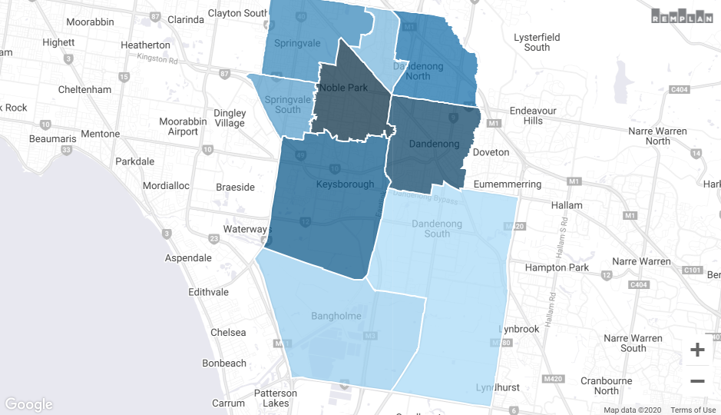
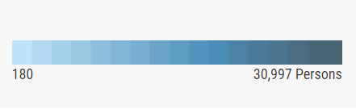
Demographics
Figure 4: Estimate population of each suburb in the Greater Dandenong region in 2019 [1]
Notes:
This map shows the distribution of the population of each suburb in 2019. Data is retrieved from Australian Bureau of Statistics.
Population among each suburb varies quite a lot. As you can see in the map, the darker colours represent densely populated regions while lighter colors show sparsely populated ones.

Slide 15
Visualisations of the data - Pet Demographics
Suburbs | Estimate population | Total pets | Pet per person
Dandenong South | 180 | 26 | 0.14444444
Bangholme | 786 | 95 | 0.12086514
Noble Park North | 7,465 | 801 | 0.10730074
Dandenong North | 22,448 | 2,393 | 0.10660192
Keysborough | 25,785 | 2,542 | 0.09858445
Noble Park | 30,997 | 2,147 | 0.06926477
Springvale South | 12,770 | 826 | 0.06468285
Springvale | 21,713 | 1,044 | 0.04808179
Dandenong | 29,901 | 1,318 | 0.04407879
*Note: Half of Lyndhurst is counted as Dandenong South as it lies across the border of the City of Casey and the city of Greater Dandenong.
Notes:
The population is consistent with the number of animals in that less populated suburbs own fewer pets.
For instance, Bangholme is one of the least populated suburb and it owns the least number of pets.
However, this table shows that the pet-per-person measure is higher for smaller suburbs.
This could be because each household in sparsely populated neighbourhoods is likely to own more pets compared to those in densely populated ones.
But we cannot conclude anything for sure as we cannot access some information needed to prove or disprove this assumption, such as the number of households owning pets.

Slide 16
Visualisations of the data - Pet Demographics
Suburbs | Most common age groups | Account for (% of population) | Most popular cat breeds | Most popular dog breeds
Dandenong South | 40-49 and 50-59 years | 51.45% | DOM, DOMSH, DOMM (in LYNDHURST) | GERM, AUSTSX, and BULLX, BORD (in Lyndhurst)
Bangholme | 60-69 and 70-79 years | 54.96% | DOM, DOMSH | GERM, LABRX
Noble Park North | 30-39 and 40-49 years | 27.89% | DOM, DOMSH | MALTX, JACK
Dandenong North | 20-29 and 30-39 years | 28.65% | DOM, DOMSH | MALTX, JACK
Keysborough | 20-29 and 30-39 years | 29.73% | DOM, DOMSH | MALTX, JACK
Noble Park | 20-29 and 30-39 years | 35.52% | DOM, DOMSH | MALTX, JACK
Springvale South | 20-29 and 30-39 years | 30.80% | DOM, DOMSH | MALTX, JACK
Springvale | 20-29 and 30-39 years | 35.09% | DOM, DOMSH | MALTX, JACK
Dandenong | 20-29 and 30-39 years | 38.46% | DOM, DOMSH | MALTX, JACK
Notes:
It appears that suburbs represented by the age group 20-39 years are more likely to own Maltese cross and Jack russell for dogs, and Domestic and Domestic Short-Haired for cats.
This suggests that there is a relationship between the age groups and the preferred breeds of animals.
However, this could also be a coincidence as there is little or no supporting evidence to confirm this observation as we are limited by these datasets.

Slide 17
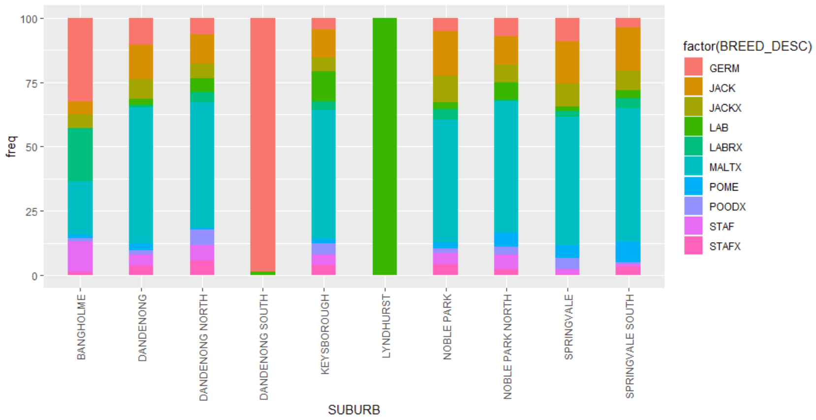
Visualisations of the data - Pet Demographics
Most suburbs have a variety of dog breeds with MALTX accounting for most of the dogs.
However, the dog breeds in Dandenong South and Lyndhurst do not vary.
All of the dogs in Lyndhurst are LABs, while most of those in Dandenong South are GERMs.
Figure 5: Percentage of the 10 most popular dog breeds by suburbs.
Notes:
The bar chart shows the frequencies of the 10 most popular dog breeds for each suburb.
Again, suburbs with the same dominant age groups, as shown in the previous table, have similar trends in terms of the popularity of the dog breeds, with MALTX being the most popular one.

Slide 18
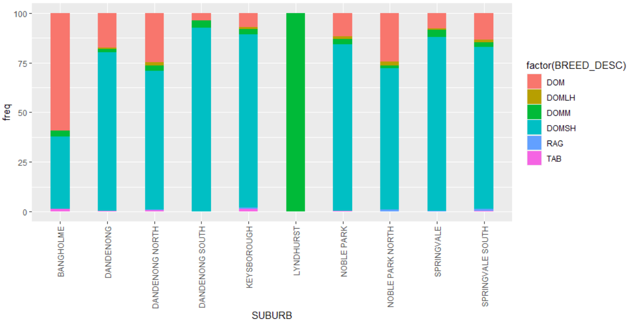
Visualisations of the data - Pet Demographics
DOMSH is popular in all suburbs, except for Lyndhurst.
DOM is the second most popular among all suburbs.
All of the cats in Lyndhurst are DOMM.
Figure 6: Percentage of the six popular cat breeds by suburbs
Notes:
Suburbs with the same dominant age groups also seem to have similar trends in terms of the popularity of the cat breeds.
Those whose dominant age group is 20-39 years are likely to have DOMSH being the most popular breed, followed by DOM.
However, these trends could be just a coincidence.
There is no certainty in the correlation between the popularity of breeds and the dominant age groups of the suburbs.

Slide 19
Visualisations of the data - Pet Demographics
Suburbs | Most common age groups | Account for (% of population) | Most popular cat colours | Most popular dog colours
Dandenong South | 40-49 and 50-59 years | 51.45% | BLACK, BLACKWHI, and TABWHI (in LYNDHURST) | BLACK, BLATAN, and BRIND, CHOC (in Lyndhurst)
Bangholme | 60-69 and 70-79 years | 54.96% | BLAWHI, GREY | BLATAN, BLAWHI
Noble Park North | 30-39 and 40-49 years | 27.89% | TRI, BLAWHI | TRI, BLAWHI
Dandenong North | 20-29 and 30-39 years | 28.65% | TRI, BLAWHI | TRI, WHITE
Keysborough | 20-29 and 30-39 years | 29.73% | TRI, BLAWHI | WHITE, BLACK
Noble Park | 20-29 and 30-39 years | 35.52% | TRI, BLAWHI | TRI, BLAWHI
Springvale South | 20-29 and 30-39 years | 30.80% | TAB, BLACWHI | TRI, WHITE
Springvale | 20-29 and 30-39 years | 35.09% | TRI, BLAWHI | TRI, BLAWHI
Dandenong | 20-29 and 30-39 years | 38.46% | TRI, BLAWHI | TRI, WHITE
Notes:
Black and white seem to be the two most popular colours.
Suburbs whose dominant age group is 20-39 years prefer tri-coloured or black and white cats, with an exception of Springvale South.
Those suburbs also seem to prefer tri-coloured dogs.
However, there is no clear trend in terms of the relationship between age groups and colours observed.

Slide 20
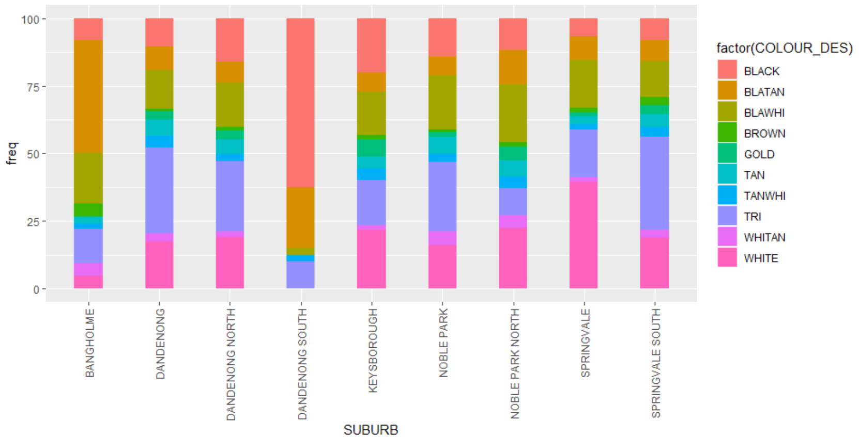
Visualisations of the data - Pet Demographics
Only 9 out of 10 suburbs are shown in the plot. This could be because Lyndhurst does not have one of these 10 breeds..
The 9 suburbs displayed have dogs with a wide variety of colours.
Figure 7: Percentage of the 10 most popular colours of dogs by suburbs
Notes:
Again, there is no clear trend among the suburbs in terms of the popularity of the dogs’ colours.
There is a variety of colours differing for each suburb.

Slide 21
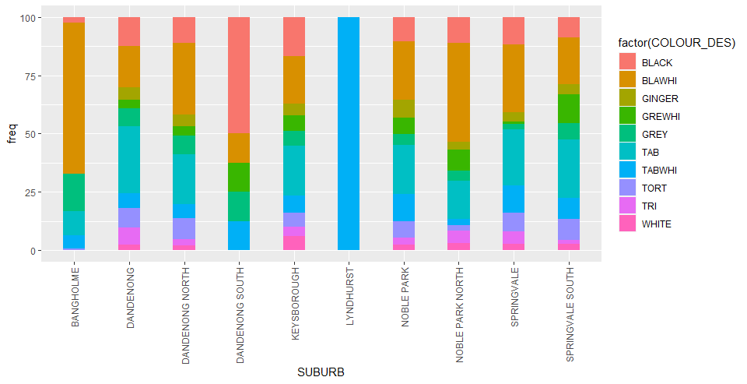
Visualisations of the data - Pet Demographics
Figure 8: The distribution of colours of cats in percentage for each suburb
Notes:
There is also no clear trend among the suburbs in terms of the popularity of the cats’ colours.

Slide 22
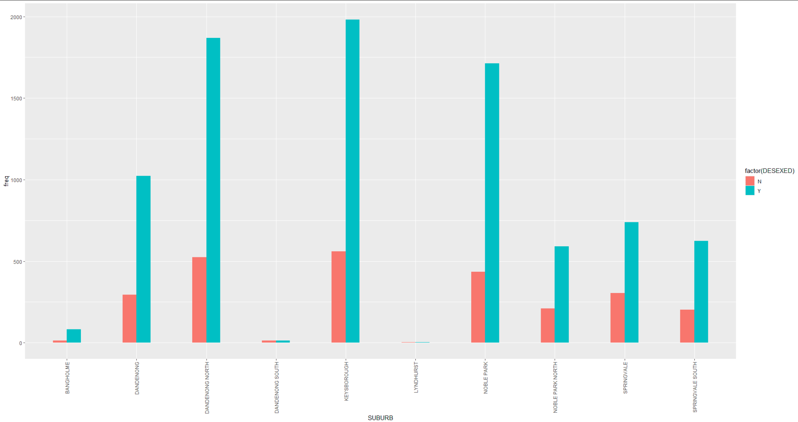
Visualisations of the data - Pet Demographics
Figure 9: Distribution of desexed and non-desexed pets by suburbs
*Note: The dataset is imbalanced with the class Desxed=Y being over-represented
Notes:
Overall, most of the animals have been desexed.
The number of desxed animals is significantly larger than the non-desexed ones, thus creating an imbalanced dataset which is later used for classification.

Slide 23
Classification
Classify whether an animal will be desexed or not

Slide 24
Preprocessing
Combining levels:
To avoid redundant levels in a categorical variable and deal with rare levels [2]
To simplify the dataset
All cross breed factors represented as a new factor “cross”
Levels that have too few samples, thus cannot represent the data, should be combined into a new level called “other”.
This also helps avoid overfitting the model and improve the accuracy
Notes:
To think about it, every individual observations of categorical and numerical data points describe one observation. The chances that two observations are exactly identical is slim. Hence, different categorical values and numerical values could be combined to create a unique merged categorical variable which contains all the different individual choices. Having this new “other” category allows new unknown factors to exist in prediction. When making new predictions any factor value that is not seen before by the classifier is converted to “other” category.

Slide 25
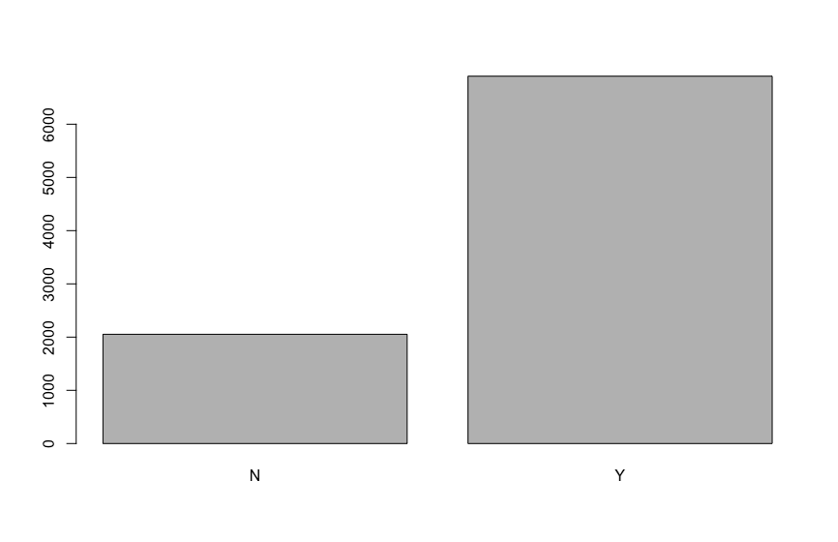

Preprocessing
Subsetting the dataset
80% of the dataset subsetted randomly is to be used as the training set.
The other 20% is to be used as the test set
TRAIN
TEST
Notes:
Imbalance with 3 times more yes than no. same distribution is maintained among both train and test set

Slide 26
Preprocessing
Feature selection
Using Chi-squared test on the training set, variables of high importance are chosen for the classification models.
We use the first 3 for all experiments
Feature | Attribute Importance
ANIMAL_TYPE | 0.27689352
BREED_DESC | 0.31114550
COLOUR_DES | 0.22745737
GENDER | 0.03923878
SUBURB | 0.07559310
POST_CODE | 0.06178761
Notes:
Chi-Square test in R is a statistical method which used to determine if two categorical variables have a significant correlation between them. The correlation between each of the predictors and the response variable is taken into account.
Like all statistical tests, we assume this test as a null hypothesis and an alternate hypothesis.
We reject the null hypothesis if the p-value that comes out in the result is less than a predetermined significance level.
Based on the Chi-squared test output in this case, three variables that have higher p-values include: …
These variables will be used as the predictors for the classification models.

Slide 27
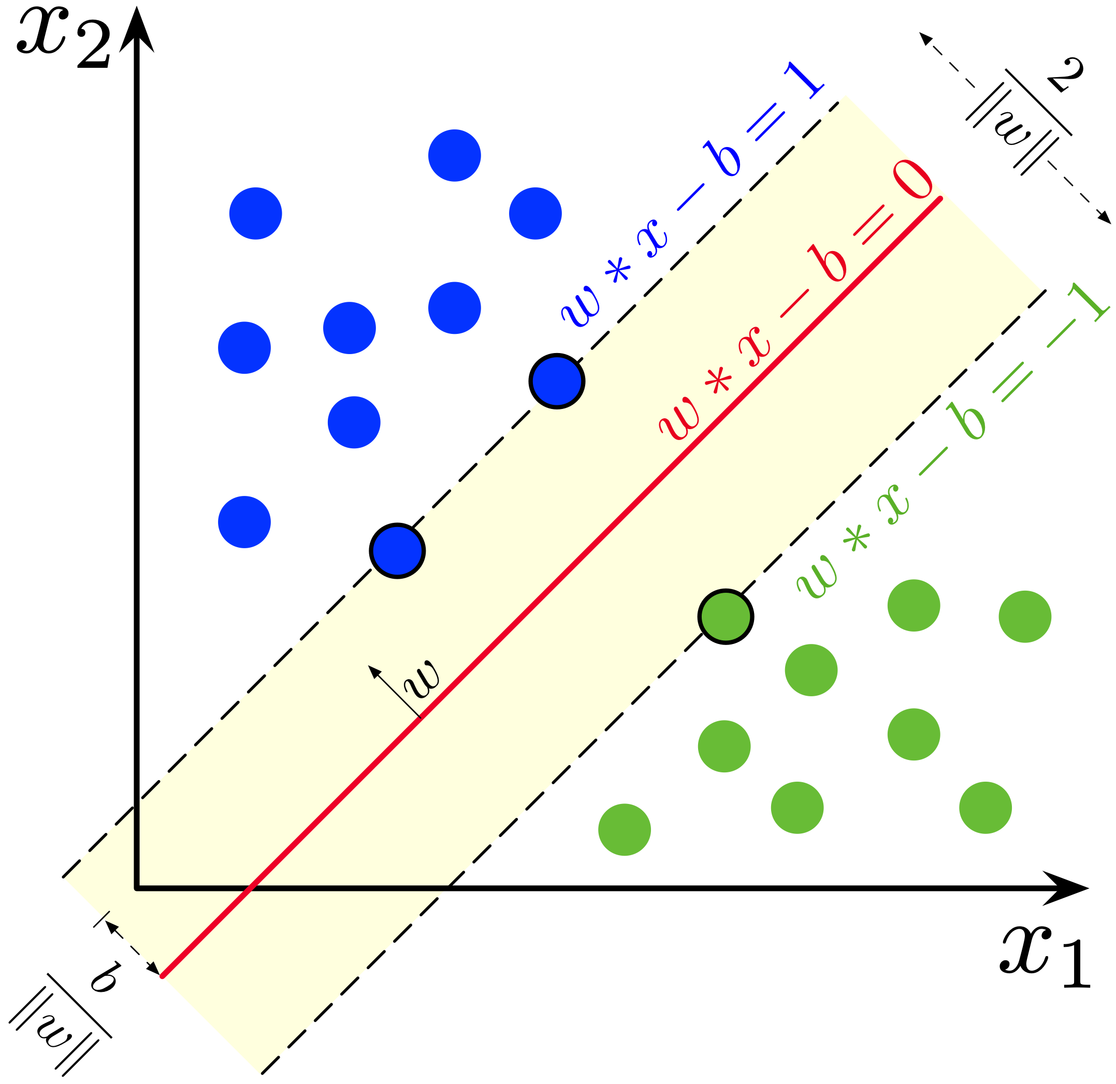
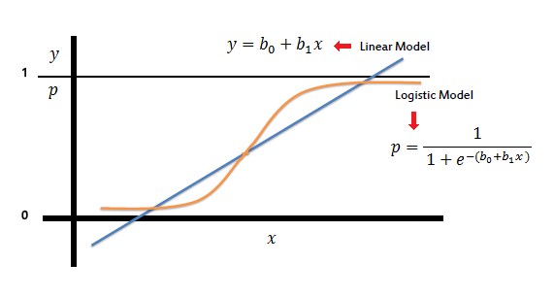
Models for classification
SVM
Logistic Regression
Notes:
We present two models selected for our classification task.

Slide 28
SVM - overview
Advantage:
SVM works relatively well when there is clear margin of separation between classes.
SVM is effective in cases where number of dimensions is greater than the number of samples.
It scales relatively well to high dimensional data.
Disadvantage:
SVM algorithm is not suitable for large data sets.
In cases where number of features for each data point exceeds the number of training data sample , the SVM will under perform.
Long training time for large datasets.

Slide 29
Logistic Regression –overview
Advantage:
Logistic Regression performs well when the dataset is linearly separable.
multicollinearity is not a problem, it can be combined with L2 regularization to solve the problem.
not only gives a measure of how relevant a predictor (coefficient size) is, but also its direction of association.
Disadvantage:
If the number of observations are lesser than the number of features, Logistic Regression should not be used, otherwise it may lead to overfit.
A large number of multi-class features or variables are not handled well.
Logistic Regression can only be used to predict discrete functions.

Slide 30
SVM experiment
Trained with default parameters and radial kernel.
Resulted in extreme biased model, all predict majority class
SVM
 | Actual
Predicted | N | Y
N | 0 | 0
Y | 505 | 1734
Notes:
As for the first experiment, we train a vanilla svm with all default parameters. However, due to the imbalance in the training set the model was highly biased to the mojority class of Y. As you can see, the model just predicts all values as yes and sice there is high proportion of yes values in the dataset it still scores a good accuracy result.

Slide 31
Cost sensitive training
Class weight to tackle class imbalance
Class weight modifies the loss function by giving penalty for misclassification of the minority class
Class weights of 3:1 applied by ratio
Optimal class weight of 2.5 : 1 found through trial and error
Notes:
To tackle this imbalance problem, we repeat the experiment with class weights applied to it. Class weights modifies loss …. . Since the ratio of data is 3 nos to 1 yes, we apply 3 , 1 to begin with and then through trial and error we find the optimal weights

Slide 32

Logistic regression
Trained using glm function with family specified as binomial(“logit”)
ANIMAL_TYPDog, BREED_DESCCross, BREED_DESCGERM, BREED_DESCROTT
Best threshold found to be 0.73 after plotting ROC curve

Slide 33
Evaluation metrics
Accuracy not enough
Use Confusion matrix, Sensitivity, Specificity and AUC instead

Slide 34
Result comparison
SVM
 | Actual
Predicted | N | Y
N | 475 | 1056
Y | 30 | 678
Logistic Regression
 | Actual
Predicted | N | Y
N | 471 | 1037
Y | 34 | 697
Models | Sensitivity | Specificity | AUC
SVM | 0.391 | 0.941 | 0.666
Logistic Regression | 0.402 | 0.933 | 0.714

Slide 35
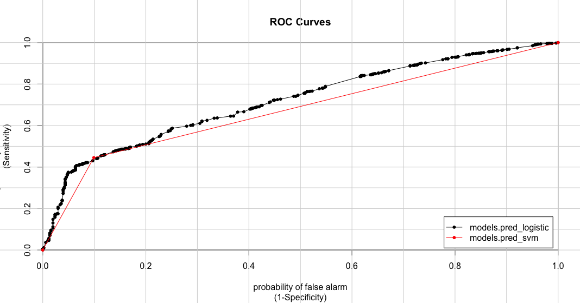
ROC comparison
Overall, the Logistic Regression performs better than the SVM.
The ROC curve for SVM is almost linear.
Logistic regression model preferred as its overall performance is relatively better
Figure 20: ROC curves plot for the two models
Notes:
The black line represents the ROC curve for the Logistic regression model while the red line represents the SVM model.
The ROC curve for Logistic regression is further from the diagonal and closer to the optimal point on the top-left corner compared to the SVM.

Slide 36
Other efforts to improve performance
Synthetic Minority Over-sampling TEchnique (SMOTE) to create synthetic data
Fine tune svm with svm.tune and step-wise regression

Slide 37
Conclusion
We studied the dataset
We found relationship between age group and breed and we also saw that high number of pets per suburb was misleading and more sparsely populated suburbs had more pets on average
Presented 2 models for classification of pets desexed
Data imbalanced and lacks good features
Notes:
To conclude, we studied the dataset that contains cats and dogs over three years old in Victoria.
The dataset contained very high level of factors and we dealt with it by merging all cross breeds into one category and mergin low frequent factors to “other” category
We then explored the demographic of the suburbs and found that average

Slide 38
Reference
[1]https://app.remplan.com.au/greaterdandenong/community/population/age?state=EyaoIQ!G9adTRv6wIZRPD5fzB75rS7IOFqF86xIJHOPmHxtg7udtQFpEwUyYV
[2] https://www.analyticsvidhya.com/blog/2015/11/easy-methods-deal-categorical-variables-predictive-modeling/

Slide 39
Thank you!

